Slide 1
Data Poisoning Attacks
Presented by Xue Hu

Slide 2
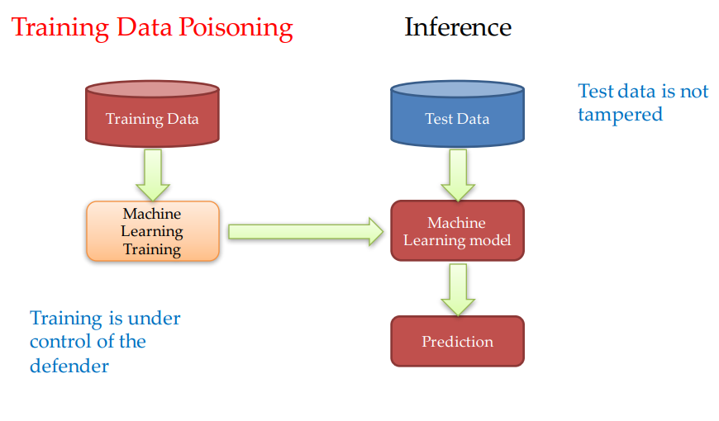
Difference from Evasion Attacks
Evasion attacks aims to find evaded data, with training data/model fixed.
Poisoning attacks aims to attack the model itself, i.e. to do modifications to the training data.

Slide 3
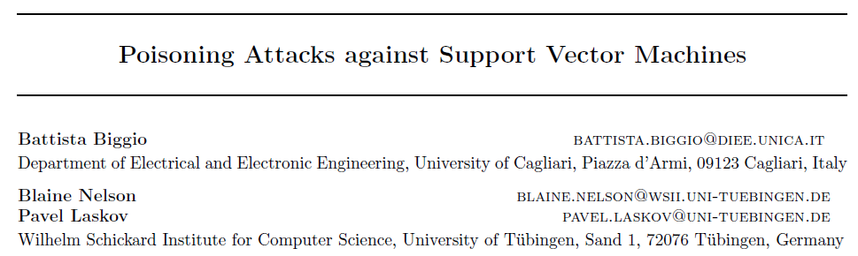

Slide 4
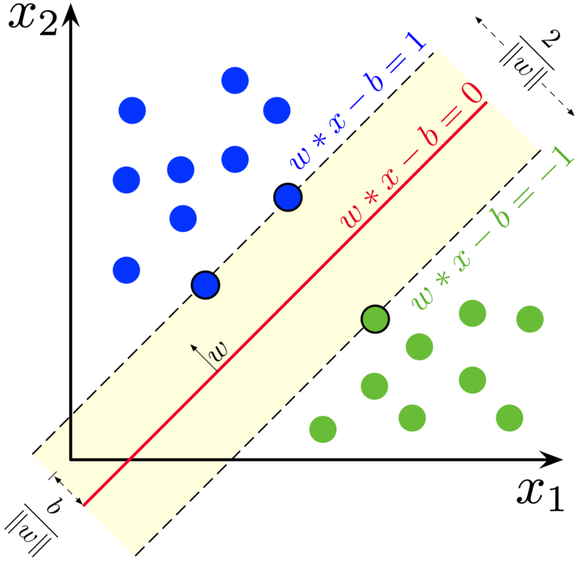
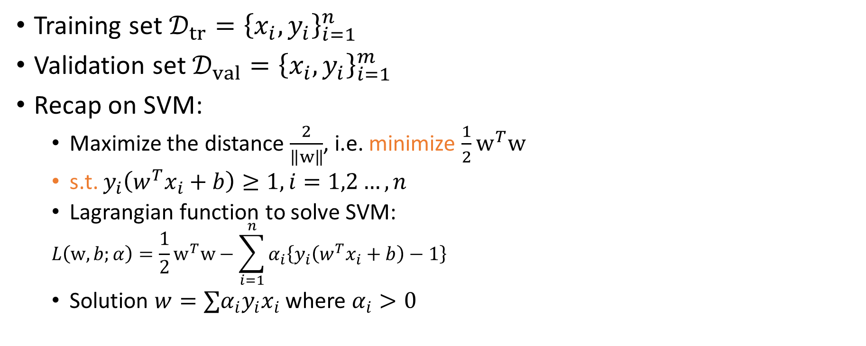
Preliminaries
Training set $𝒟_{tr}={\left\{x_{i},y_{i}\right\}}_{i=1}^{n}$
Validation set $𝒟_{val}={\left\{x_{i},y_{i}\right\}}_{i=1}^{m}$
Recap on SVM:
Maximize the distance $\frac{2}{\left\|w\right\|}$, i.e. minimize $\frac{1}{2}w^{T}w$
s.t. $y_{i}\left(w^{T}x_{i}+b\right)≥1, i=1,2…,n$
Lagrangian function to solve SVM:
$$L\left(w,b;α\right)=\frac{1}{2}w^{T}w−\sum_{i=1}^{n}{α_{i}\left\{y_{i}\left(w^{T}x_{i}+b\right)−1\right\}}$$
Solution $w=∑α_{i}y_{i}x_{i}$ where $α_{i}>0$

Slide 5
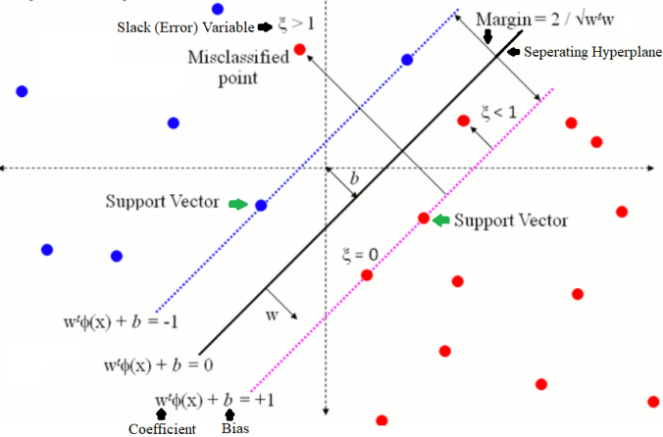
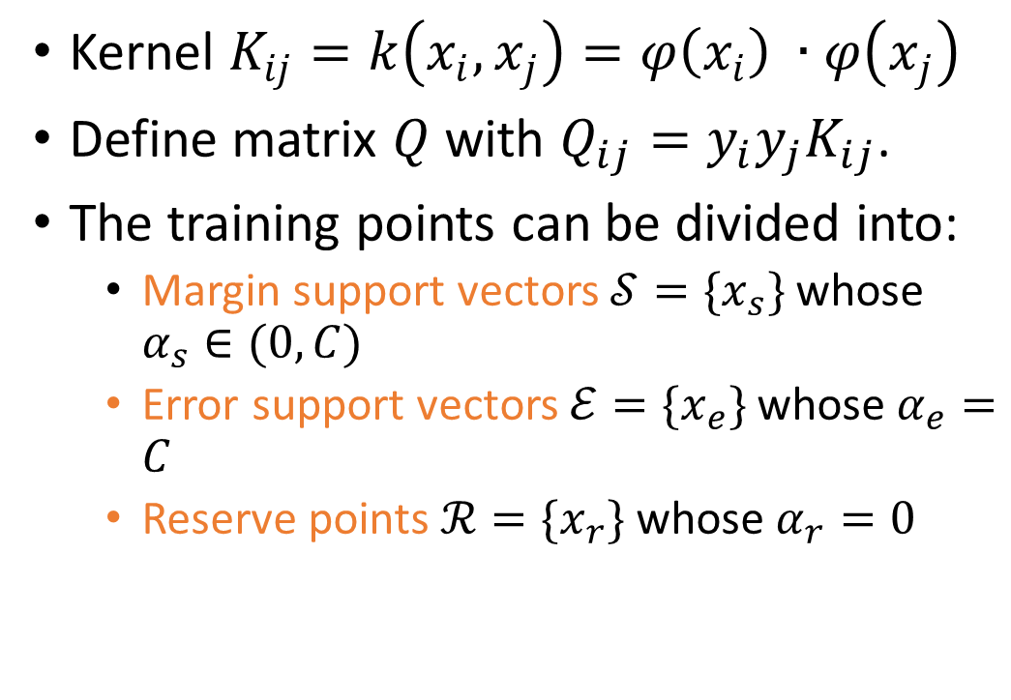
Preliminaries
Kernel $K_{ij}=k\left(x_{i},x_{j}\right)=φ\left(x_{i}\right) ∙φ\left(x_{j}\right)$
Define matrix $Q$ with $Q_{ij}=y_{i}y_{j}K_{ij}$.
The training points can be divided into:
Margin support vectors $𝒮=\{x_{s}\}$whose $α_{s}∈(0,C)$
Error support vectors $ℰ=\{x_{e}\}$whose $α_{e}=C$
Reserve points $ℛ=\{x_{r}\}$whose $α_{r}=0$

Slide 6
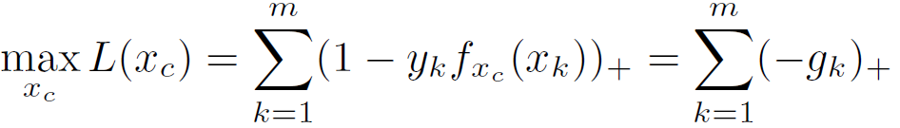
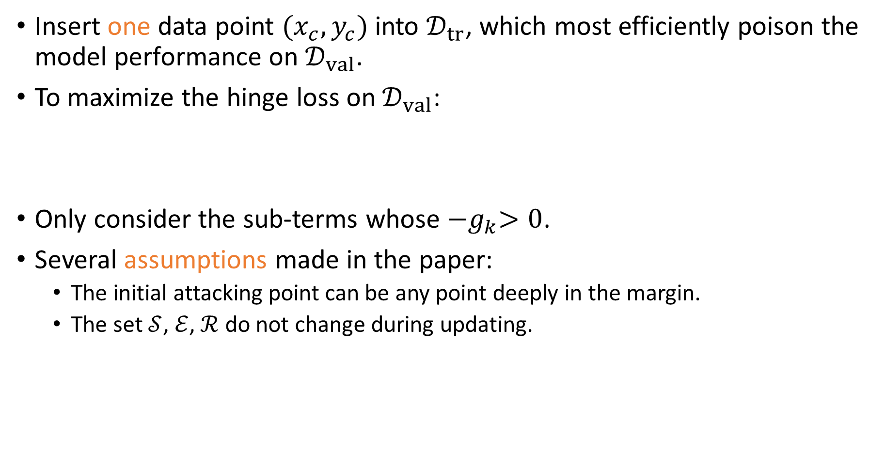
Single Point Poisoning Against SVM
Insert one data point $(x_{c},y_{c})$ into $𝒟_{tr}$, which most efficiently poison the model performance on $𝒟_{val}$.
To maximize the hinge loss on $𝒟_{val}$:
Only consider the sub-terms whose ${−g}_{k}>0$.
Several assumptions made in the paper:
The initial attacking point can be any point deeply in the margin.
The set $𝒮$, $ℰ$, $ℛ$ do not change during updating.

Slide 7
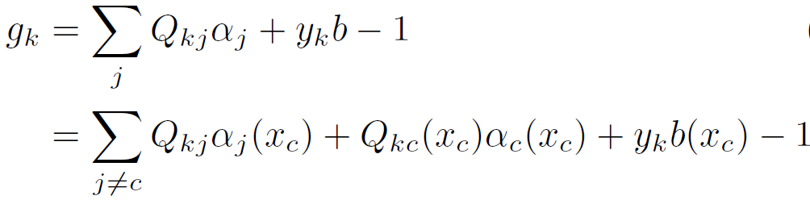


Calculating the Gradient
Update $x_{c}$ iteratively: $x_{c}^{(p)}=x_{c}^{(p−1)}+t∙u$. In each iteration, set $u$to a unit vector aligned with $\frac{∂L}{∂u}=\sum_{k=1}^{m}{\frac{−∂g_{k}}{∂u}}$.

Slide 8
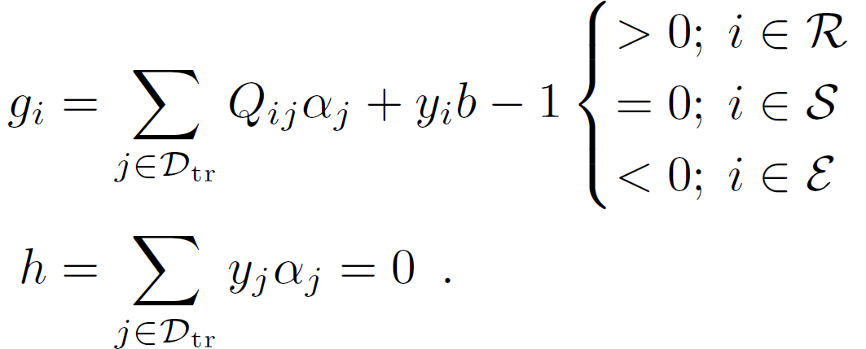
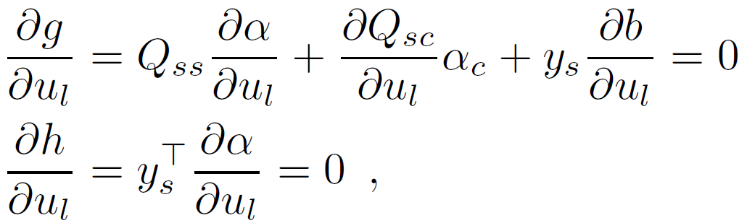
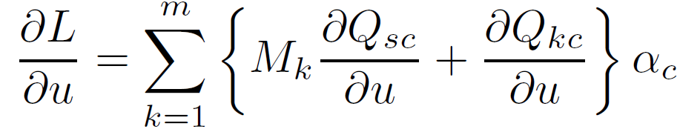
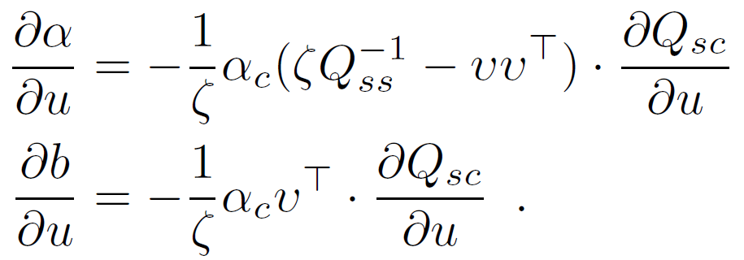
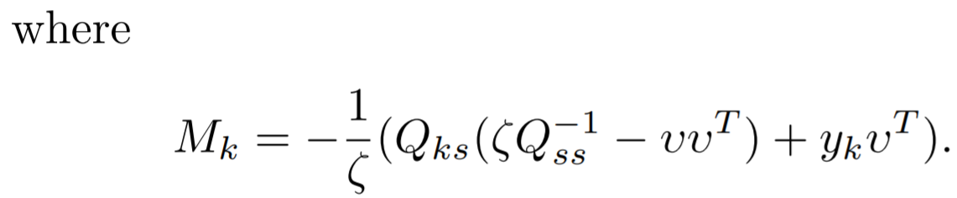

Calculating the Gradient
The KKT conditions of the SVM training:
More details:
For each $training point in 𝒮$:
Notes:
simultaneous equations

Slide 9
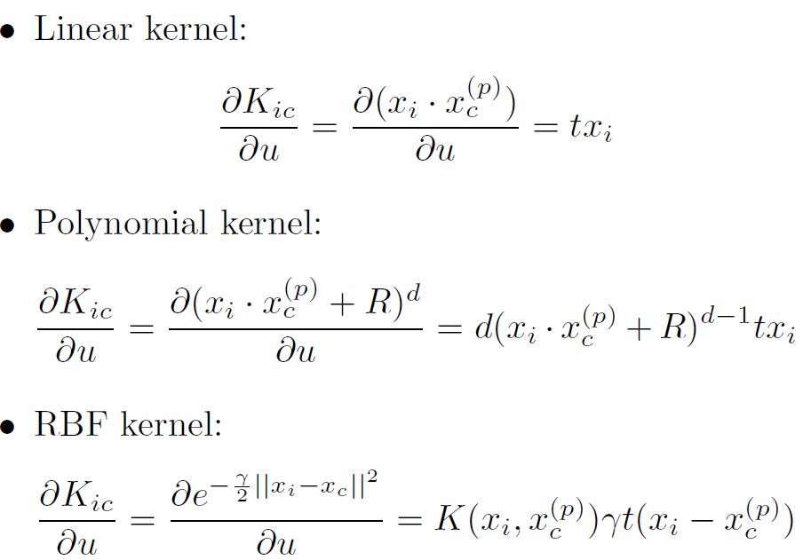
Single Point Poisoning Against SVM
Kernelization:

Slide 10
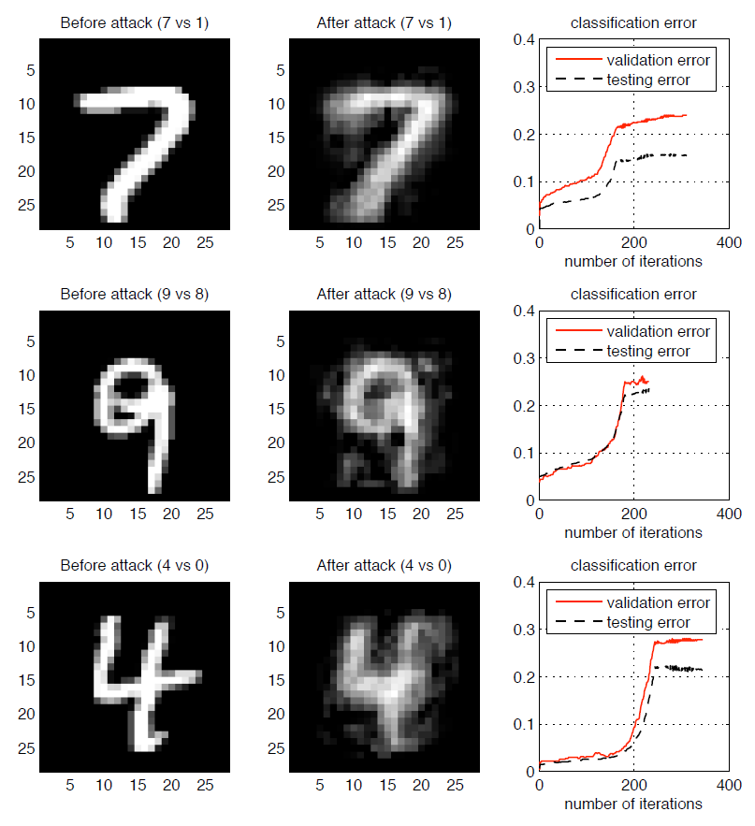
Experiments
The validation error and testing error are both increased due to the attack.
The perturbation forces the original image to be more like the opposite class.
A single attack data point caused the classification error to rise from the initial error rates of 2-5% to 15-20%.

Slide 11
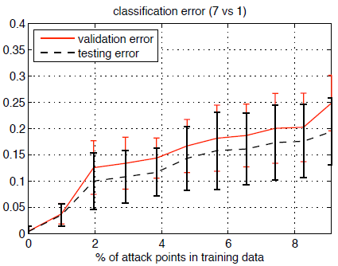
Future work
Add constraint to the perturbation.
Multi-point Poisoning: finding the optimal subset to attack.
Incorporate inverse feature mapping problem.
Extension to Multi-point Poisoning

Slide 12
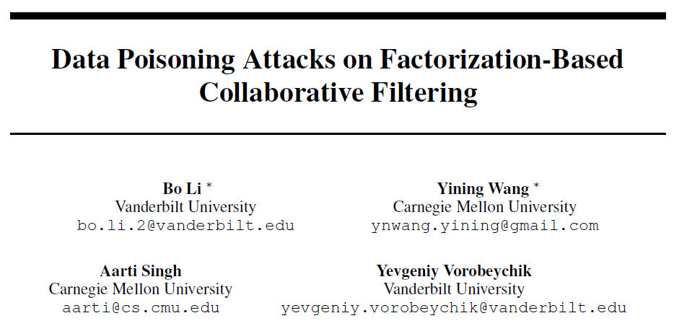

Slide 13

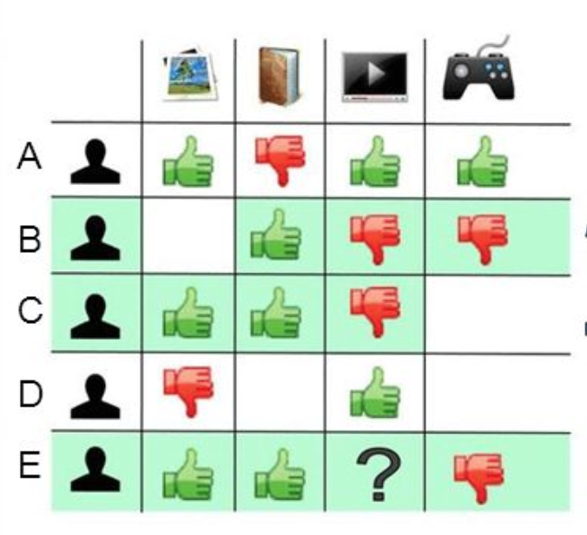
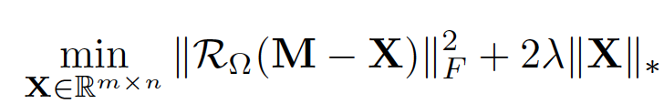


Preliminaries
Collaborative Filtering:
Given , with the observable entries
Goal: matrix completion.
$M$ can be recovered by
Two approaches:
Alternating minimization
Nuclear norm minimization
where
Notes:
σk(X) denotes the kth largest singular value of X

Slide 14



Attacking Formulation
The attack model:
Inject $\tilde{M}$ into $M,$ where $\tilde{M}∈$
The formulations will be:
Alternating minimization to learn
Nuclear norm minimization to learn

Slide 15


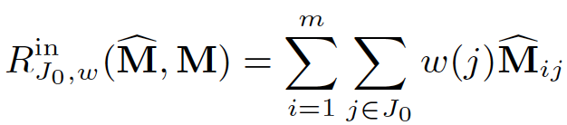

Attacking Formulation
Goal:
Typical attacker utilities:
Availability attack:
where $\overline{M}={UV}^{T}$ in the case of no poisoning
Integrity attack:
Hybrid attack:
attacker’s utility

Slide 16

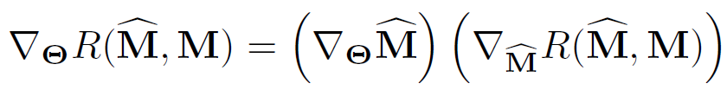
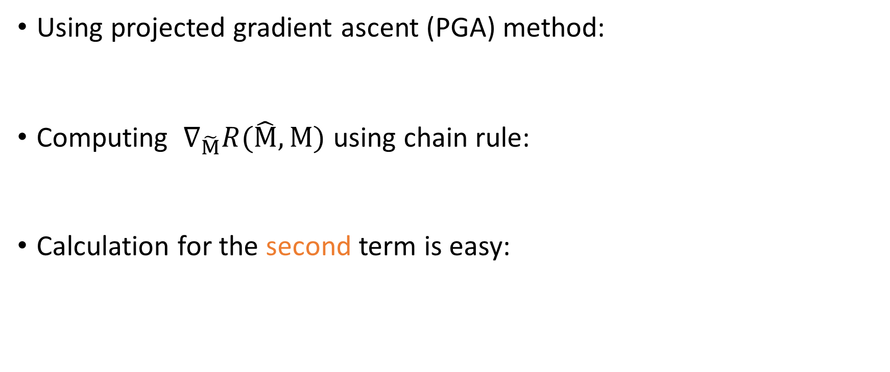
Computing Optimal Attack Strategies
Using projected gradient ascent (PGA) method:
Computing $∇_{\tilde{M}}R(\hat{M},M)$ using chain rule:
Calculation for the second term is easy:

Slide 17


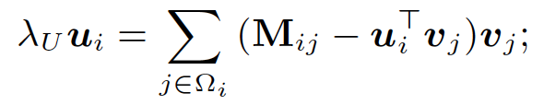
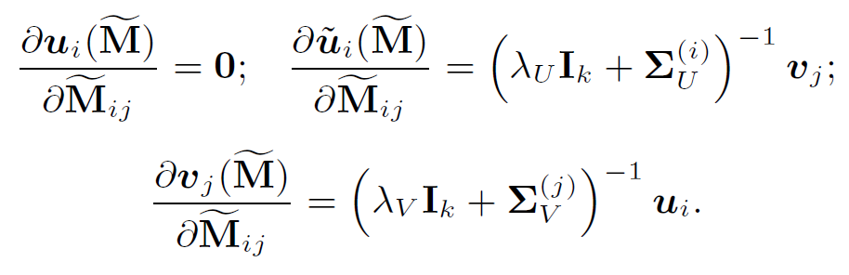
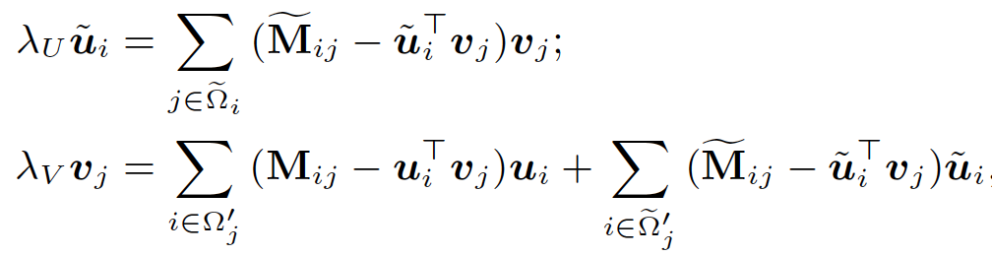
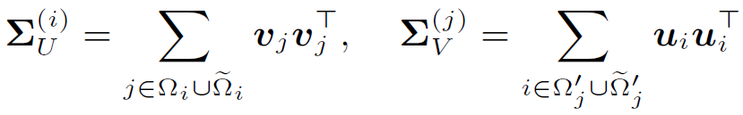
Computing Optimal Attack Strategies
Attacking alternating minimization:
To compute , use the KKT conditions of

Slide 18





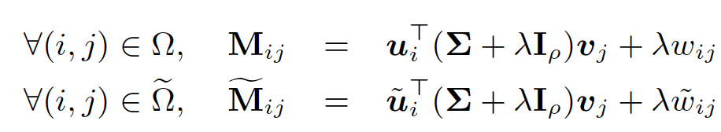

Computing Optimal Attack Strategies
Attacking nuclear norm minimization:
Use as an alternative characterization with fewer parameters. Do singular value decompositions (SVD) for both $X$ and $\tilde{X}$ so that
Still apply the KKT conditions:
Subdifferential of the nuclear norm function

Slide 19
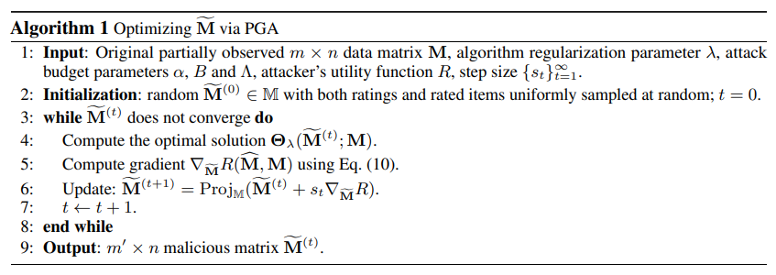
Computing Optimal Attack Strategies

Slide 20

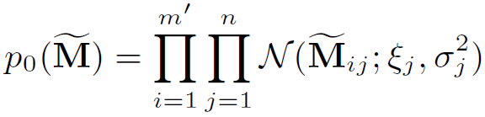

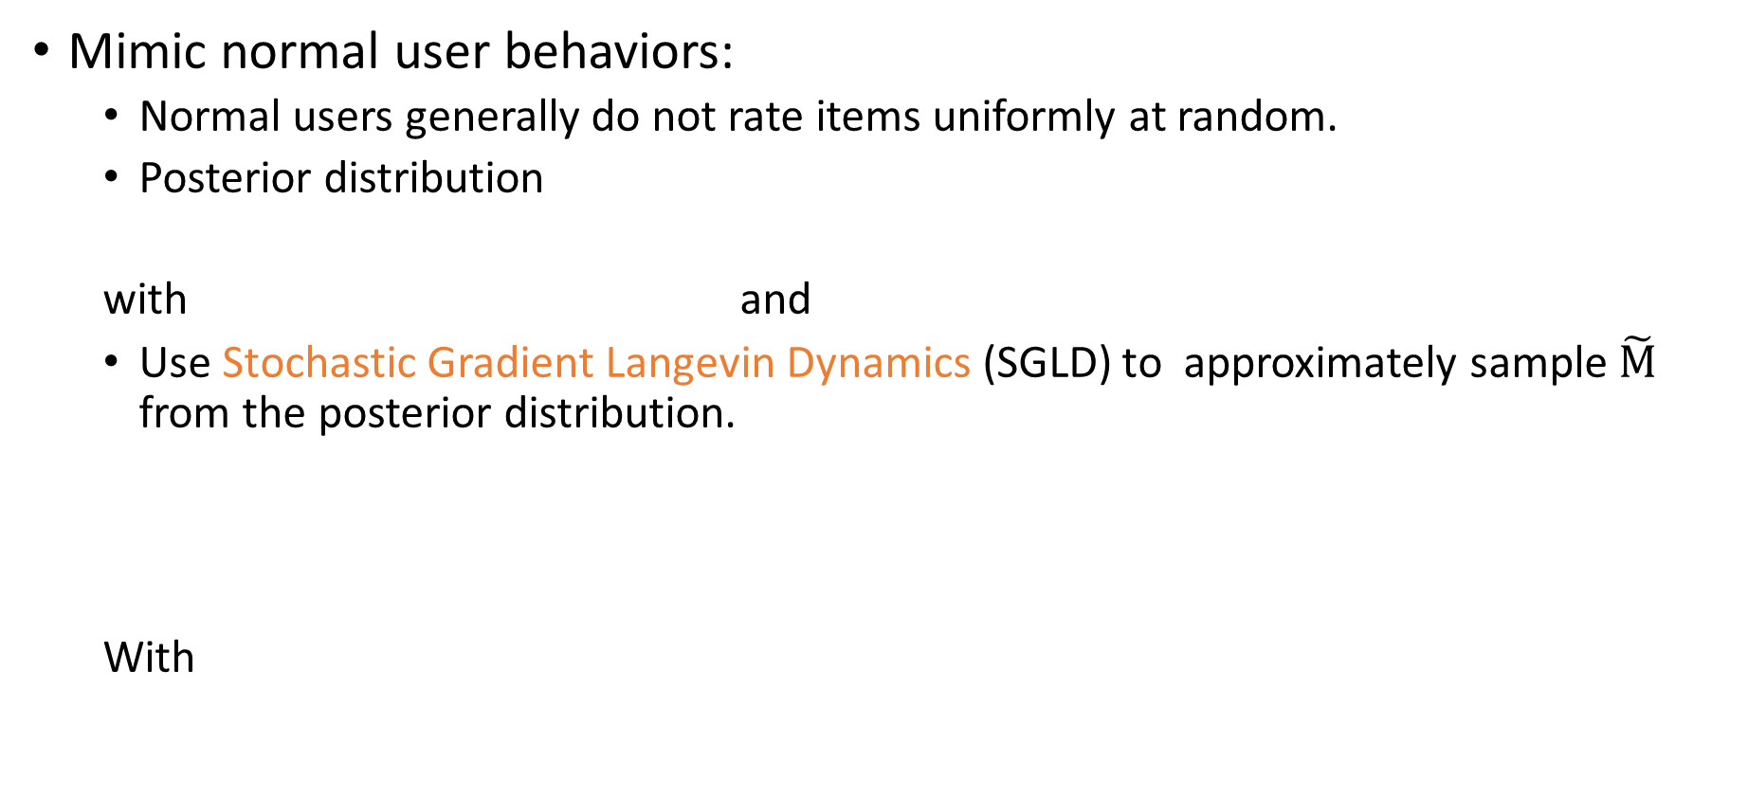
Computing Optimal Attack Strategies
Mimic normal user behaviors:
Normal users generally do not rate items uniformly at random.
Posterior distribution
with and
Use Stochastic Gradient Langevin Dynamics (SGLD) to approximately sample $\tilde{M}$ from the posterior distribution.
With
Notes:
Beta is a tuning parameter that trades off attack performance and detection avoidance.

Slide 21
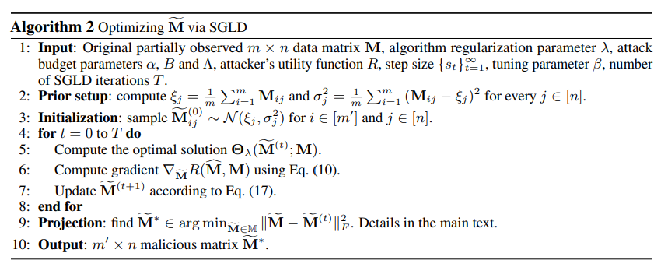
Computing Optimal Attack Strategies
Mimic normal user behaviors:

Slide 22
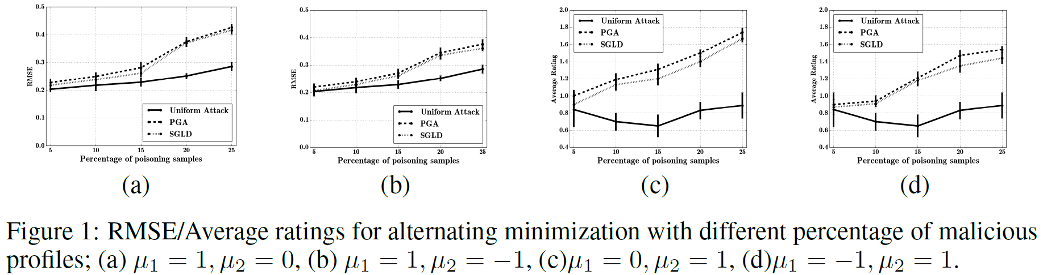
Experiments
MovieLens dataset: 27k movies by 138k users.
Results on hybrid attack:

Slide 23
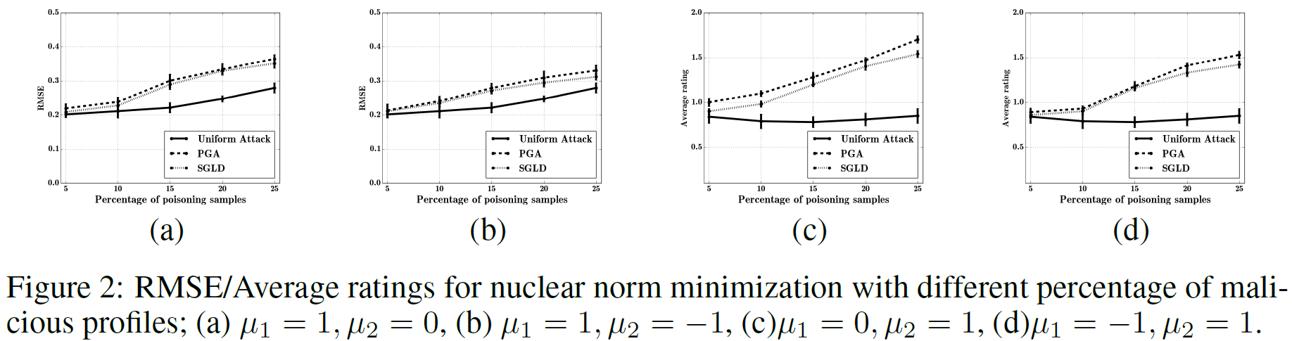
Experiments
MovieLens dataset: 27k movies by 138k users.
Results on hybrid attack:
Notes:
PGA performs slightly better than SGLD.
SGLD is harder to detect than PGA.

Slide 24
Future work
The ultimate goal of the poisoning attack analysis is to defend.
Possible defensive strategies:
Tracking and detecting deviations in the feature correlations and other accuracy metrics.
Apply the combinational models or sampling strategies, such as bagging, to reduce the influence of poisoning attacks.
Notes:
talk about the difference between poisoning and evasion.
For the SVM paper, talk about how to derive from the total loss to the gradient is calculated.
For CF, do not have to go into details.

